Slide 1
Graphical computation of convolution

Slide 2
Topics Representation of DT Signals Response of DT LTI Systems Convolution Examples Properties
Notes:
MS Equation 3.0 was used with settings of: 18, 12, 8, 18, 12.

Slide 3
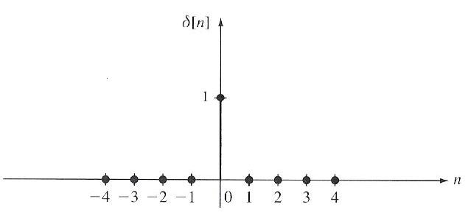
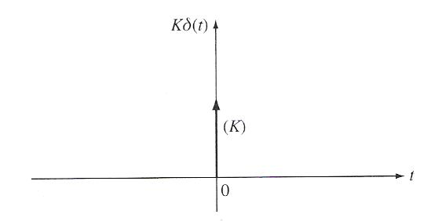
Exploiting Superposition and Time-Invariance
DT LTI
System
So for all “basic” signals, x_{k}[n]
We can represent any signal as a linear combination (e.g, weighted sum) of these building blocks.
The response of an LTI system to these basic signals is easy to compute and provides significant insight.
For LTI Systems (CT or DT) there are two natural choices for these building blocks:
There are many families of such functions: sinusoids, exponentials, and even data-dependent functions. The latter are extremely useful in compression and pattern recognition applications.
DT Systems: (unit pulse)
CT Systems: (impulse)

Slide 4
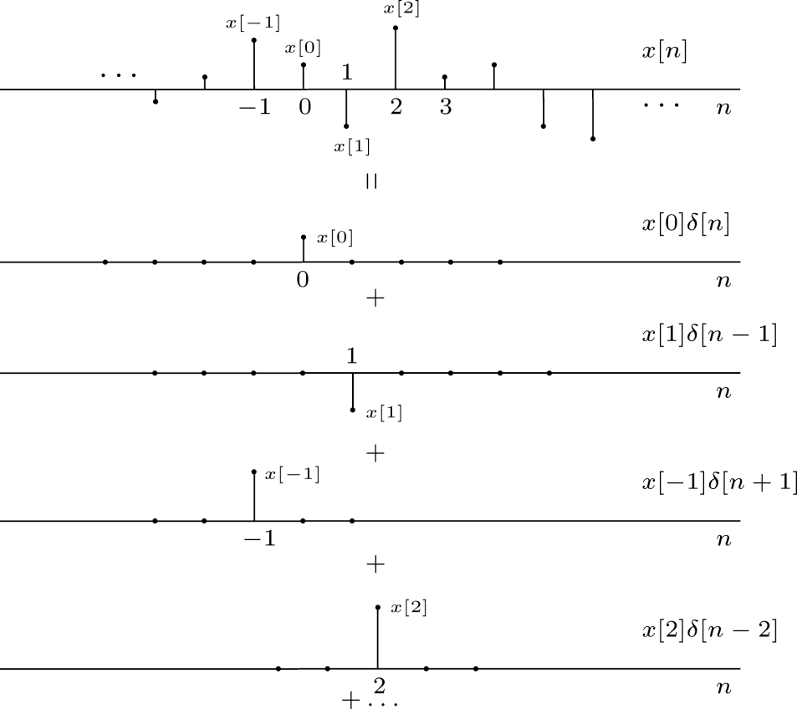
Representation of DT Signals Using Unit Pulses

Slide 5
Response of a DT LTI Systems – Convolution
DT LTI
The unit pulse response, h[n], is the response of a DT LTI system to a unit pulse function, δ[n].
Using the principle of time-invariance:
Using the principle of linearity:
Comments:
Recall that linearity implies the weighted sum of input signals will produce a similar weighted sum of output signals.
Each unit pulse function, δ[n-k], produces a corresponding time-delayed version of the system impulse response function (h[n-k]).
The summation is referred to as the convolution sum.
The symbol “*” is used to denote the convolution operation.
convolution operator
convolution sum

Slide 6
LTI Systems and Impulse Response
The output of any DT LTI is a convolution of the input signal with the unit pulse response:
Any DT LTI system is completely characterized by its unit pulse response.
Convolution has a simple graphical interpretation:
DT LTI

Slide 7
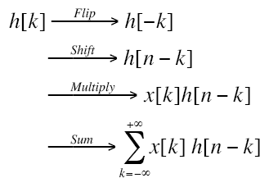
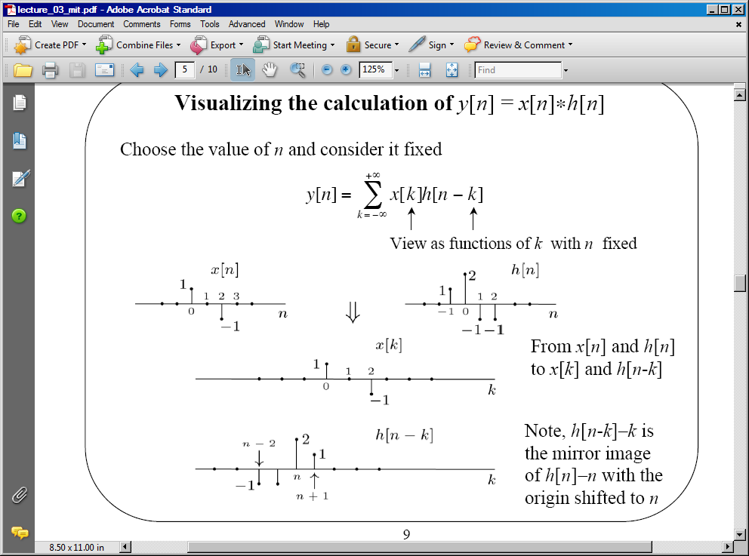
Visualizing Convolution
There are four basic steps to the calculation:
The operation has a simple graphical interpretation:

Slide 8
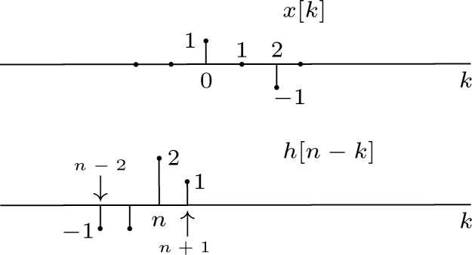
Calculating Successive Values
We can calculate each output point by shifting the unit pulse response one sample at a time:
y[n] = 0 for n < ???
y[-1] =
y[0] =
y[1] =
…
y[n] = 0 for n > ???
Can we generalize this result?

Slide 9
Graphical Convolution
2
1
-1
-1
1
-1
k = -6 -5 -4 -3 -2 -1 0 1 2 3 4 5 6 7 8 9

Slide 10
Graphical Convolution (Cont.)
2
1
-1
-1
1
-1
k = -6 -5 -4 -3 -2 -1 0 1 2 3 4 5 6 7 8 9

Slide 11

Discrete Convolution
5 samples
3 samples

Slide 12
Graphical Convolution (Cont.)
Observations:
y[n] = 0 for n > 4
If we define the duration of h[n] as the difference in time from the first nonzero sample to the last nonzero sample, the duration of h[n], L_{h}, is 4 samples.
Similarly, L_{x} = 3.
The duration of y[n] is: L_{y} = L_{x} + L_{h} – 1. This is a good sanity check.
The fact that the output has a duration longer than the input indicates that convolution often acts like a low pass filter and smoothes the signal.

Slide 13
Examples of DT Convolution
Example: unit-pulse
Example: delayed unit-pulse
Example: unit step
Example: integration

Slide 14
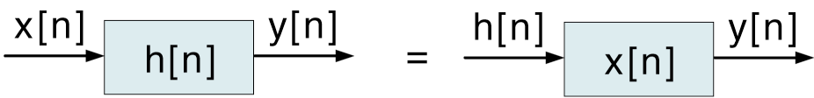
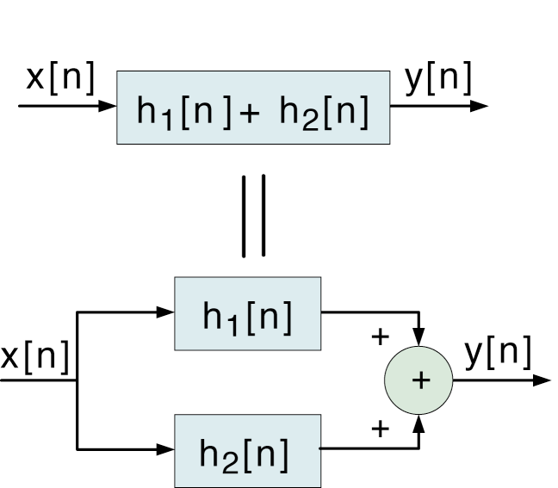
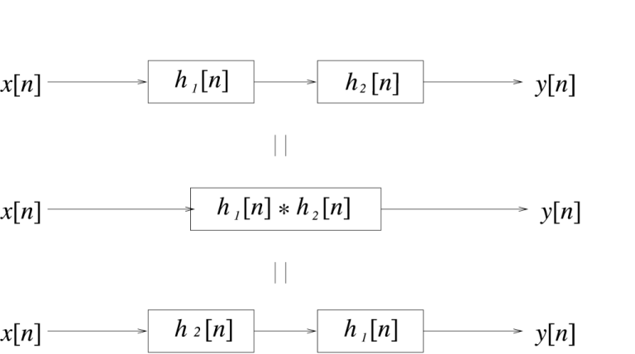
Properties of Convolution
Commutative:
Implications
Distributive:
Associative:

Slide 15
Useful Properties of (DT) LTI Systems
Causality:
Stability:
Bounded Input ↔ Bounded Output

Slide 16
Summary
We introduced a method for computing the output of a discrete-time (DT) linear time-invariant (LTI) system known as convolution.
We demonstrated how this operation can be performed analytically and graphically.
We discussed three important properties: commutative, associative and distributive.
we can determine key properties of a system, such as causality and stability, by examining the system impulse response.

